Slide 1
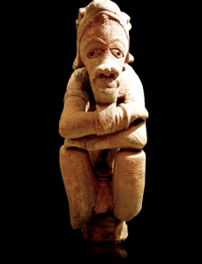
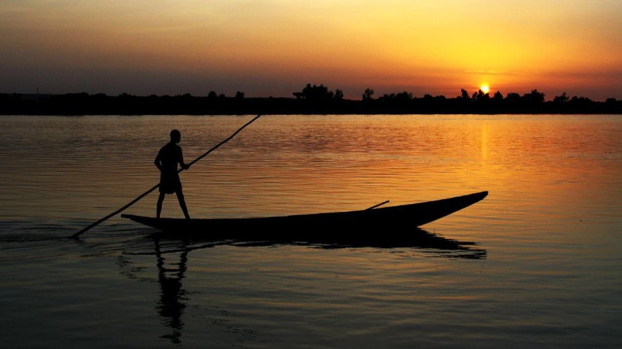
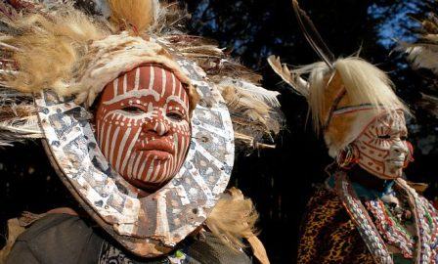
Africa South of the Sahara
History and Government

Slide 2
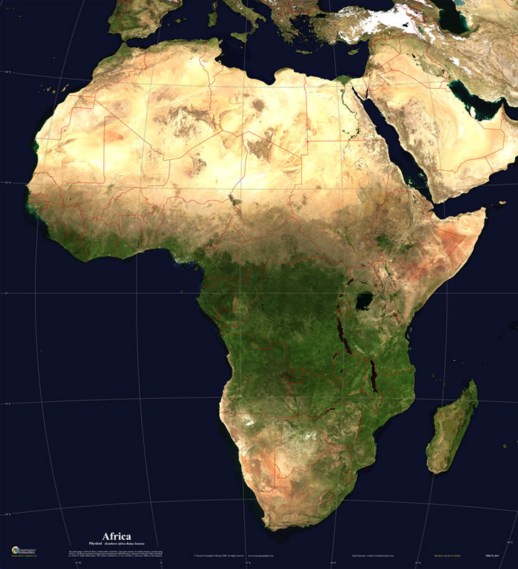
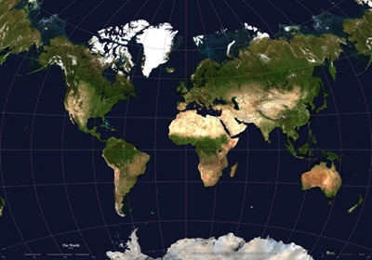
AFRICA AND THE WORLD

Slide 3
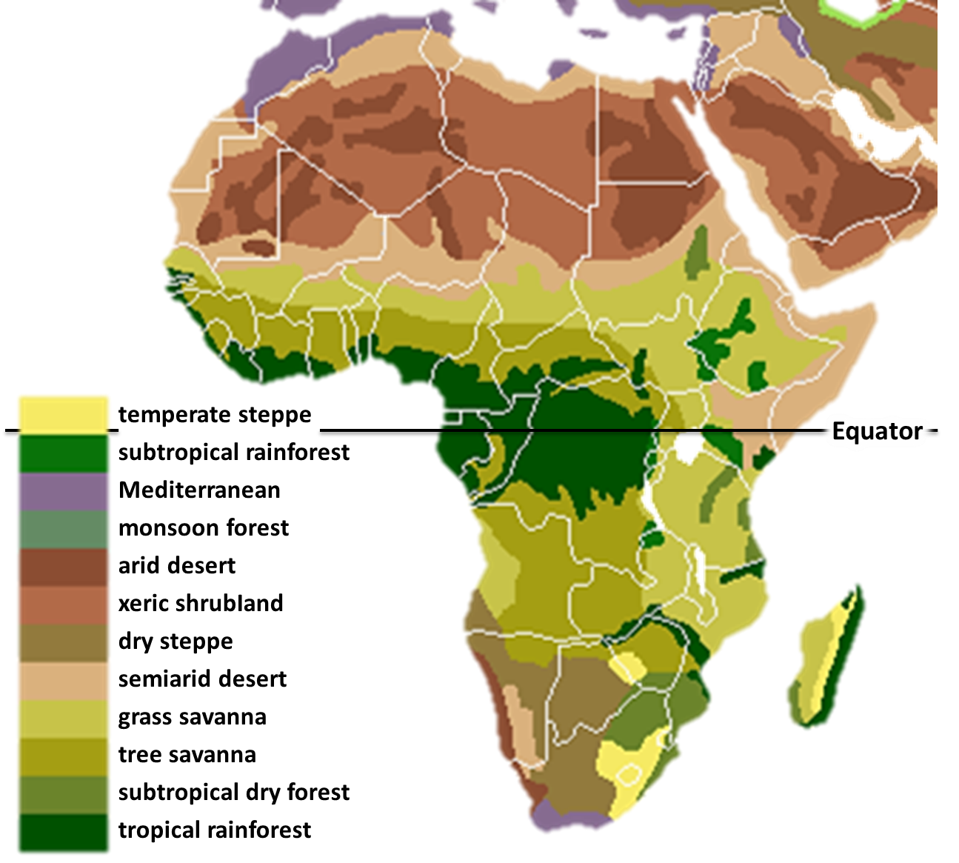
AFRICA BIOSPHERES

Slide 4
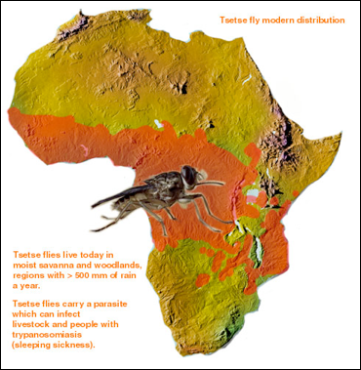

Slide 5
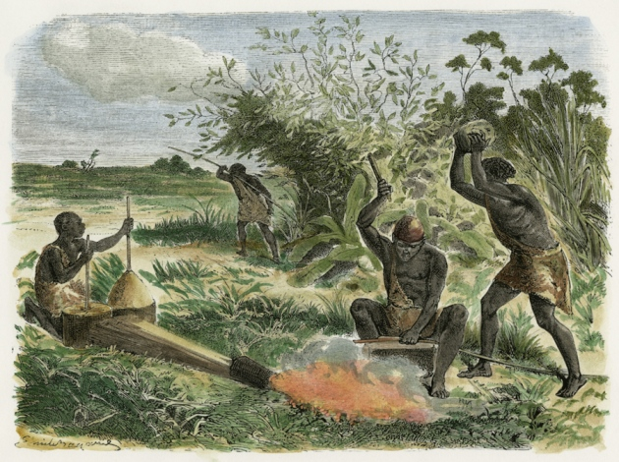
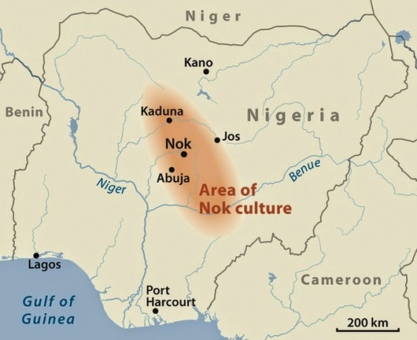
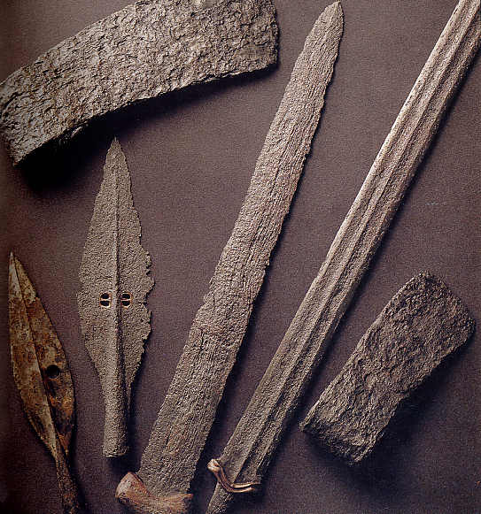
WEST AFRICAN IRON AGE
Began around 500 B.C.E
Started just north of Niger and Benue Rivers
First civilization to practice ironworking was the Nok culture
Iron used for several purposes

Slide 6
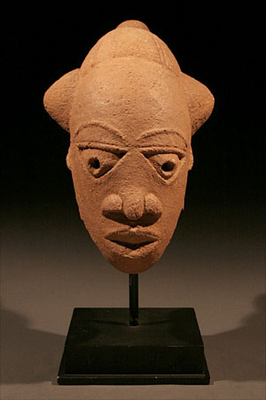
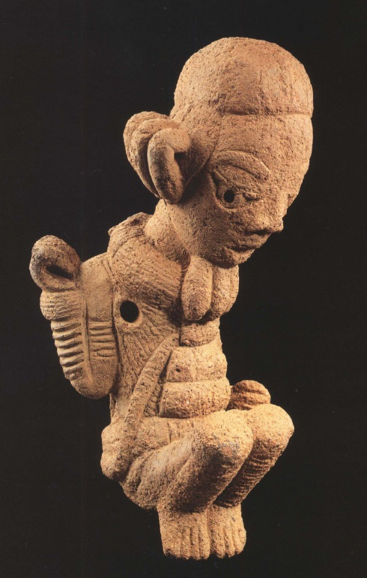
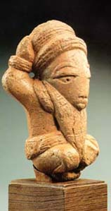
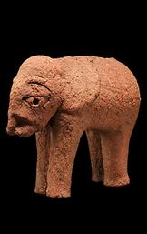
NOK SCULPTURES

Slide 7
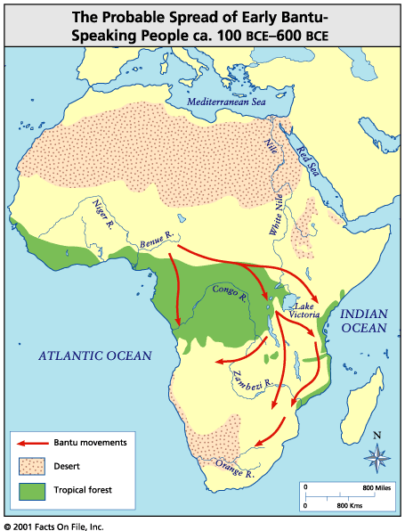
First Civilizations
2000 BC – People fleeing Sahel – climate getting hotter and drier
Once hunter-gatherers but learned to DOMESTICATE, or tame, animals and use agriculture
Took with them knowledge of raising crops and animals
Bantu settlements go back to AD 800
  Spread across 1/3 of Africa
150 millions Bantu language speakers today

Slide 8
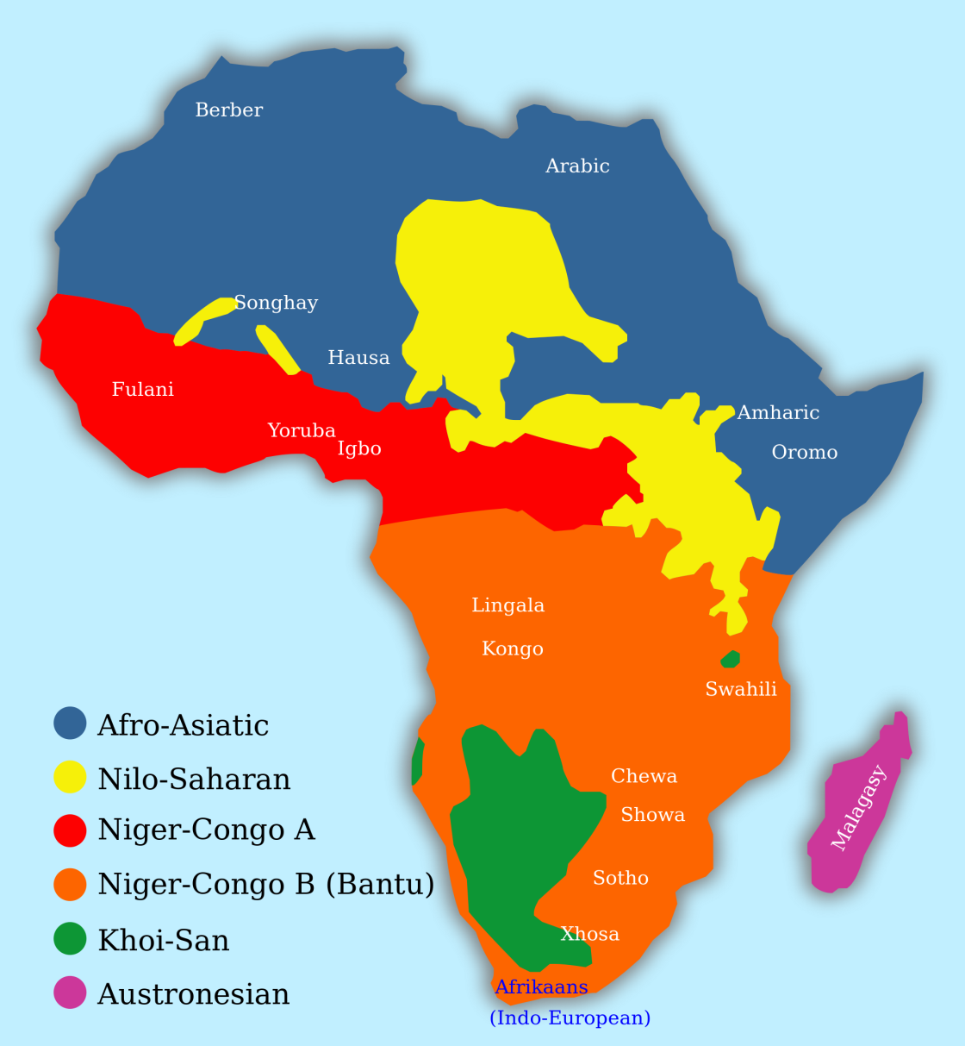
AFRICA LANGUAGE MAP

Slide 9
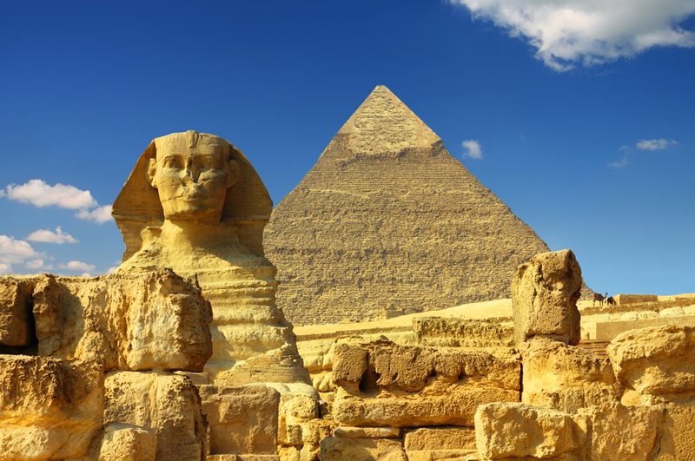
First Civilizations II
Nile Valley remained fertile area – gave birth to Egyptian civilization
2000 BC-1000 BC – Egyptians move South, bring other cultures under their control
Kingdom of Kush (present-day Sudan) – brought rule into Egyptian territory
Built civilization around capital - Meroe
300s AD – Trade routes of Kush attacked by AXUM – powerful trading empire in Northern Ethiopia

Slide 10
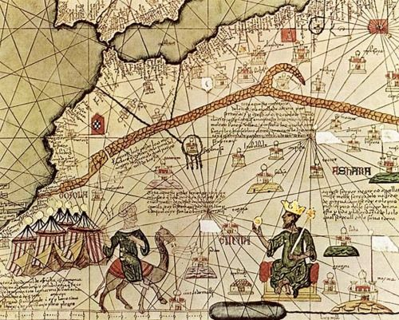
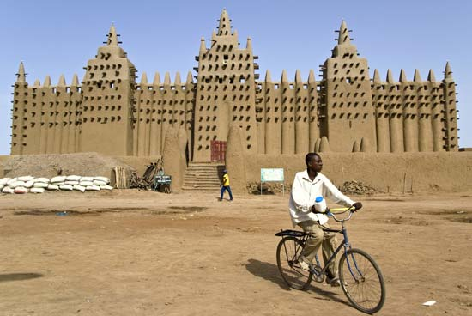
West Africa’s
Trading Empires
Trading empires
  AD 800s-1500s
  1. Ghana
    Controlled trade routes across Sahara
      $$$ - Gold for salt
  2. Mali
    Replaced Ghana
      $$$ - gold for salt
    Famous leader - Mansa Musa
    Famous city - Timbuktu
  3. Songhai
    Took over Mali
    Famous leader – Muhammad Toure
      Muslim

Slide 11
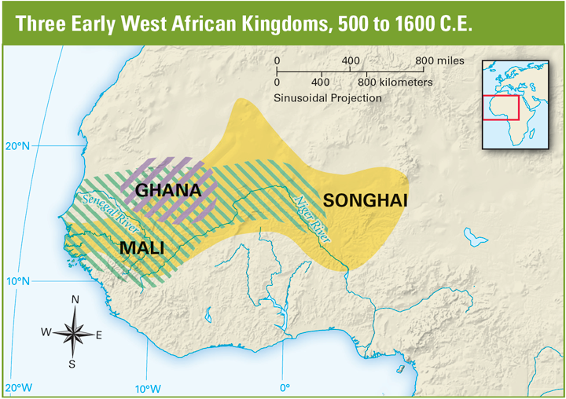
Empires in the West
700s AD – emergence of GHANA
  Grew rich by trading gold for salt from camel caravans across Sahara
  Much gold in Ghana
    Wealth shown in capital of KUMBI
  Empire created tax collection system and charged tariffs

Slide 12
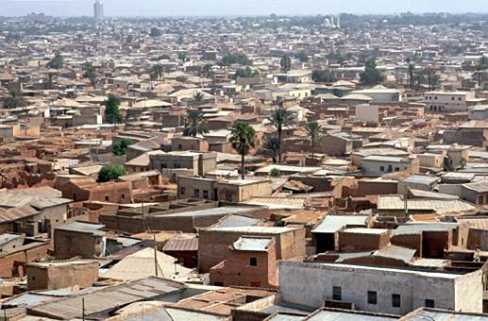
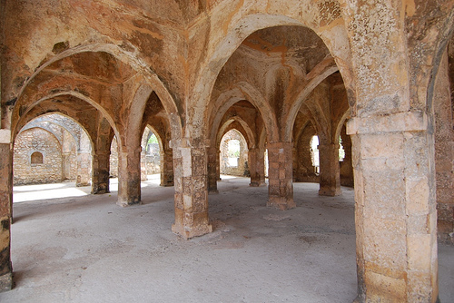
European & Africa I
Word of Africa’s wealth reached Europe in Middle Ages
Trade with Africa started AD 1200s
Age of Exploration
  Portuguese
    Set up trading stations on African coast
    Enslaved Africans
    Travelers reach trading centers
      inland (West Africa) Timbuktu, Kano, Gao
      coast (East Africa): Kilwa, Mombasa, Sofala

Slide 13
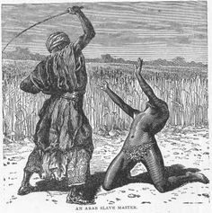
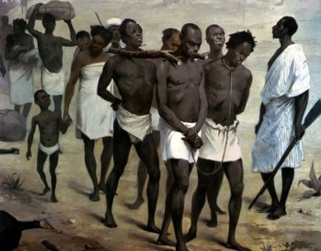
Slave Trade in Africa
Arab slave trade
  From 800s AD
    Slaves from East Africa to Near East
European Slave Trade
  Need slaves, gold, ivory, textiles
  Slaves to New World
    Work on sugar, tobacco, rice, and cotton plantations
    Middle Passage
      Horrible journey across Atlantic – millions die

Slide 14
Europe and Africa II
Europe – 19th century
  Colonies as markets for goods and raw materials
  Site for Christian missionaries
  National prestige
  Carving up of Africa (1885)
    Ignored ethnic boundaries
      Led to conflict between ethnic groups
    Created “tribes”
    Economic exploitation
      Production of cash crops
    Only Liberia and Ethiopia remained independent

Slide 15
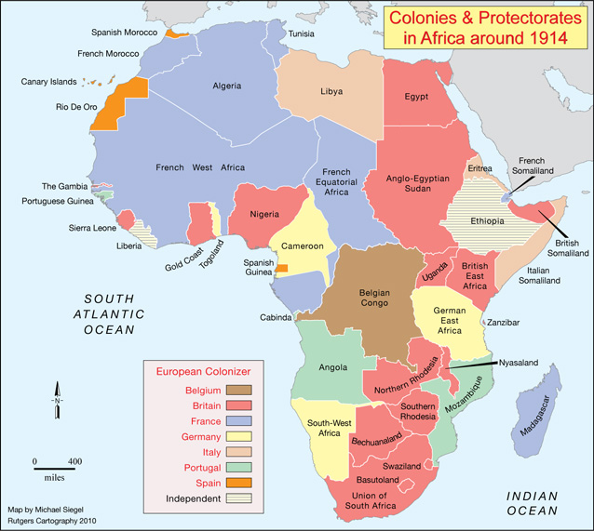

Slide 16
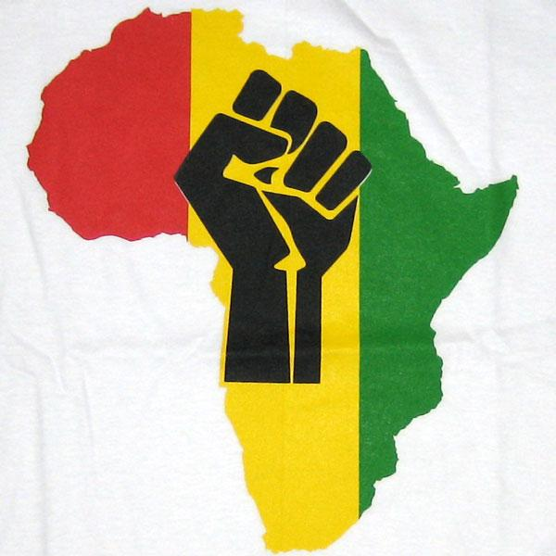
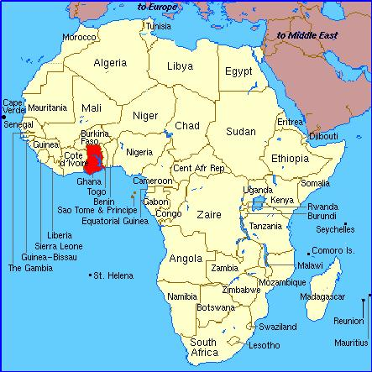
Struggle for Freedom
Early 1900s
  NATIONALISM spreads among Africans
    NATIONALISM is a people’s desire to rule themselves and have their own independent country
    Africans protested against DISCRIMINATION – unfair and unequal treatment of a group
      Most Europeans did not listen but after World War II Europe too weak to stop African independence
        British colony – Gold Coast
          Becomes independent nation of GHANA in 1957

Slide 17
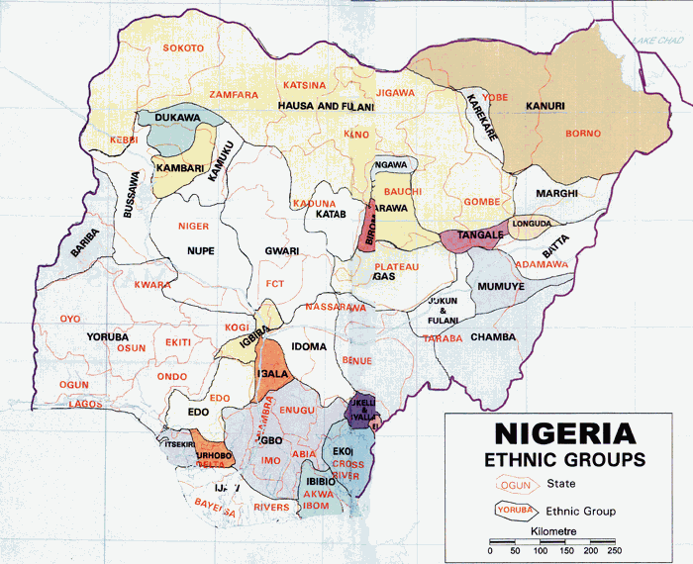
After Independence
Many new countries kept old colonial borders
  Different ethnic/religious groups now part of same country
    Civil wars
      Many people became REFUGEES – people who flee to another country to escape mistreatment or disaster

Slide 18
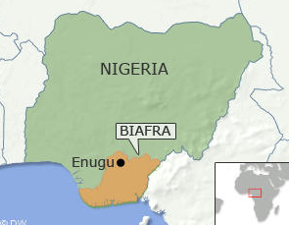
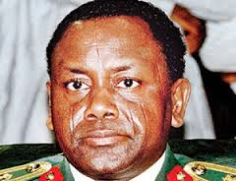
From Colonies to Countries
Positives under Colonial Rule
  Educational opportunities
  City development
Lingering Difficulties
  Economies that serve European interests
  Colonial government
    Excluded most Africans
    Few democratic models
  Borders issue
    Africa kept most European nation-state boundaries
      Case study: Nigeria
        British created country from tribal patchwork
        North Muslims, South Christian
          Civil War – 1960
        Military rule – coups, coups, and more coups

Slide 19
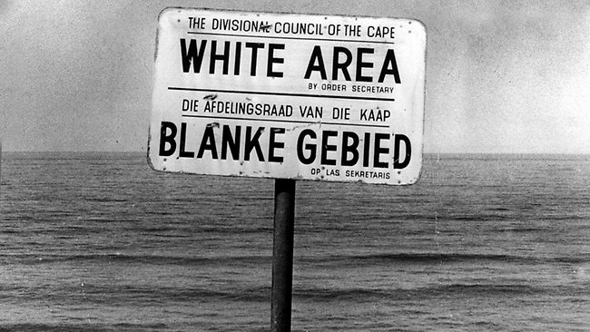
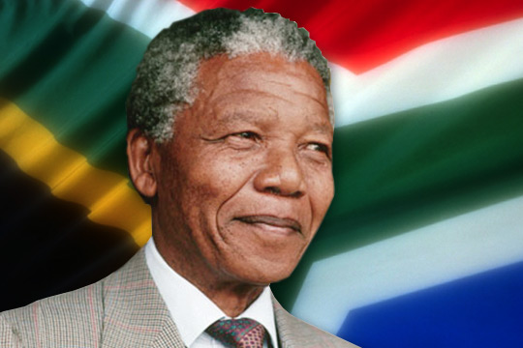
South Africa & Apartheid
In South Africa a small white population ruled over a large black population
  Law was called APARTHEID
    “apartness” - non-whites forced to live in separate areas with no freedom
      Non-Europeans not allowed to vote
  Black South African fought Apartheid
    NELSON MANDELA – black leader who was put in prison for over 20 years
      Later freed and became first President of South Africa
      Apartheid ended

Slide 20
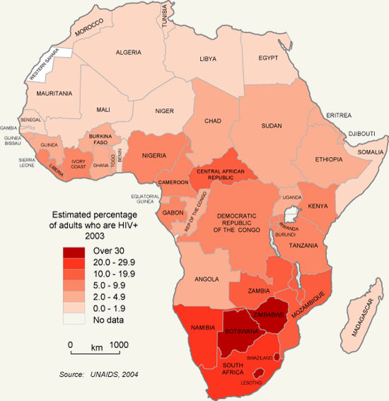
AIDS in Africa

Slide 21
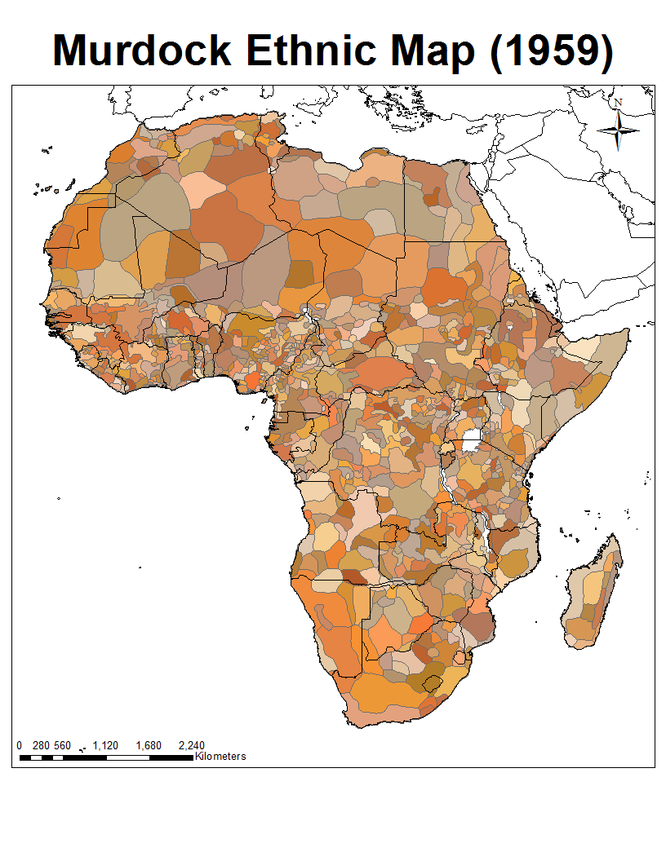
Culture in Africa South of the Sahara
Many different ethnic groups in Africa
  Africa is not one place with one group!!!
  2,000-3,000 languages
    Swahili – 50 million people speak it!
    European languages – why?
      English, French, Portuguese

Slide 22
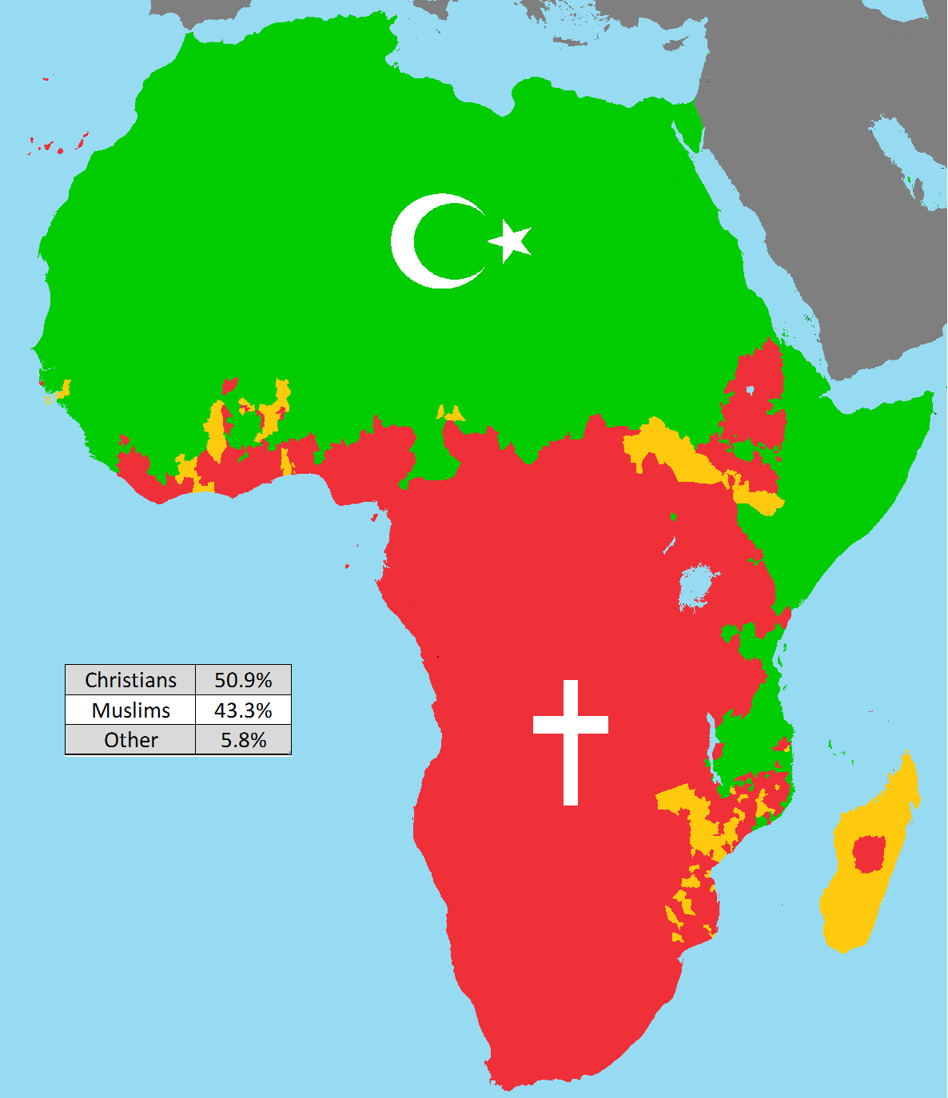
Culture and Africa II
Religion
  Islam
    Mostly Muslims in West Africa
  Christianity
    Found in many coastal areas
  Traditional Religions
    Spirits of ancestors
    Many gods
    Spirits affect events
  Religious Conflict
    Examples: Sudan, Nigeria
      Christianity and traditional religions vs. Islam

